Slide 1
Reinforcement Learning
via Path Integrals
Tyler Foster

Slide 2
Basic setup.

Slide 3
Basic setup.
An agent (or agents) occupy a given set of possible states over time.

Slide 4

Basic setup.
An agent (or agents) occupy a given set of possible states over time.
Example 1. Discrete movement in a plane. We have one agent. The state of the agent, at a given time, is its position in some bounded subregion of a rank-2 (discrete) lattice in the plane.

Slide 5
Basic setup.
An agent (or agents) occupy a given set of possible states over time.
Example 1. Discrete movement in a plane. We have one agent. The state of the agent, at a given time, is its position in some bounded subregion of a rank-2 (discrete) lattice in the plane.
Example 2. The game of Go. We have two agents. They compete in a game of Go. Their shared state, at a given time, is the specific arrangement of black and white stones on the Go board.

Slide 6
Basic setup.
An agent (or agents) occupy a given set of possible states over time.
Example 1. Discrete movement in a plane. We have one agent. The state of the agent, at a given time, is its position in some bounded subregion of a rank-2 (discrete) lattice in the plane.
Example 2. The game of Go. We have two agents. They compete in a game of Go. Their shared state, at a given time, is the specific arrangement of black and white stones on the Go board.
Example 3. Voice leading. We have one agent. The agent plays a sequence of (4-note) musical chords. The state of the agent, at a given time, is the chord the agent is playing.

Slide 7
Actions.

Slide 8
Actions.
At each time step, one of the agents changes the state by carrying out an action.

Slide 9
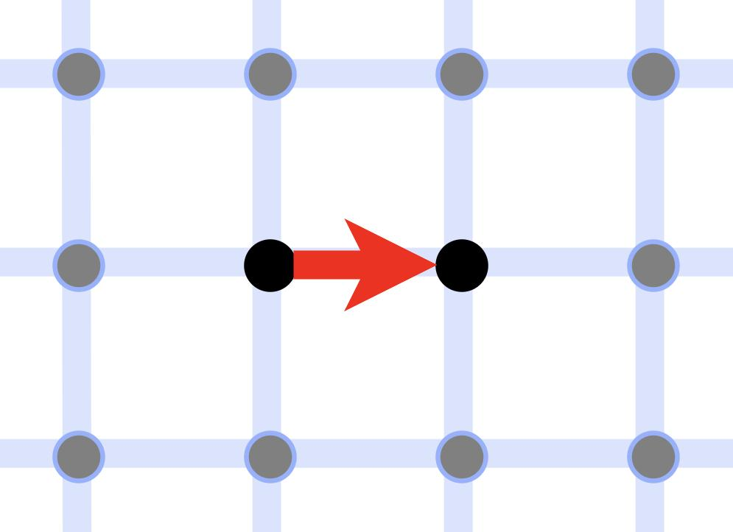
Actions.
At each time step, one of the agents changes the state by carrying out an action.
Example 1. Discrete movement in a plane. The agent moves to a position adjacent to its present position on the 2-dimensional grid.

Slide 10
Actions.
At each time step, one of the agents changes the state by carrying out an action.
Example 1. Discrete movement in a plane. The agent moves to a position adjacent to its present position on the 2-dimensional grid.
Example 2. The game of Go. The agent whose turn it is places a stone on the board and makes appropriate changes to other stones on the board.

Slide 11
Actions.
At each time step, one of the agents changes the state by carrying out an action.
Example 1. Discrete movement in a plane. The agent moves to a position adjacent to its present position on the 2-dimensional grid.
Example 2. The game of Go. The agent whose turn it is places a stone on the board and makes appropriate changes to other stones on the board.
Example 3. The agent plays a the next chord.

Slide 12
Returns.

Slide 13
Returns.
After one full episode, all agents receive a numerical return for their performance.

Slide 14
Returns.
After one full episode, all agents receive a numerical return for their performance.
Example 1. Discrete movement in a plane. Certain grid points have health points. An episode consists of a fixed number of steps the agent is allowed to take. The agent’s return is the total number of health points the agent obtains over the episode.

Slide 15
Returns.
After one full episode, all agents receive a numerical return for their performance.
Example 1. Discrete movement in a plane. Certain grid points have health points. An episode consists of a fixed number of steps the agent is allowed to take. The agent’s return is the total number of health points the agent obtains over the episode.
Example 2. The game of Go. An episode is a single game of Go. The return to each agent at the end of an episode is that agent’s final score (sum of the number of stones that agent has on the board and the number of empty intersections the agent surrounds).

Slide 16
Returns.
After one full episode, all agents receive a numerical return for their performance.
Example 1. Discrete movement in a plane. Certain grid points have health points. An episode consists of a fixed number of steps the agent is allowed to take. The agent’s return is the total number of health points the agent obtains over the episode.
Example 2. The game of Go. An episode is a single game of Go. The return to each agent at the end of an episode is that agent’s final score (sum of the number of stones that agent has on the board and the number of empty intersections the agent surrounds).
Example 3. Voice leading. An episode is one full chord sequence, say 8 measures. The return is a numerical measure of how well the chord sequence meets the rules of counterpoint

Slide 17
Returns.
After one full episode, all agents receive a numerical return for their performance.
Example 1. Discrete movement in a plane. Certain grid points have health points. An episode consists of a fixed number of steps the agent is allowed to take. The agent’s return is the total number of health points the agent obtains over the episode.
Example 2. The game of Go. An episode is a single game of Go. The return to each agent at the end of an episode is that agent’s final score (sum of the number of stones that agent has on the board and the number of empty intersections the agent surrounds).
Example 3. Voice leading. An episode is one full chord sequence, say 8 measures. The return is a numerical measure of how well the chord sequence meets the rules of counterpoint (these can be made numerical, for instance deduced from all the rule in Tonal Counterpoint for the 21st-Century Musician).

Slide 18
Goal of each agent:

Slide 19
Goal of each agent:
Choose actions so as to maximize return at end of episode.

Slide 20
Goal of each agent:
Choose actions so as to maximize return at end of episode.
Central problem in reinforcement learning:

Slide 21
Goal of each agent:
Choose actions so as to maximize return at end of episode.
Central problem in reinforcement learning:
How do we equip an agent with an action-choosing policy that maximizes that agent’s return at the end of each episode?
(strategy)

Slide 22
Think about the problem geometrically.

Slide 23
State space.
Think about the problem geometrically.

Slide 24
State space.
Think about the problem geometrically.
We can think of the set of all possible states as forming something like a manifold, with “nearby states” being those an agent can get to by unit actions.

Slide 25
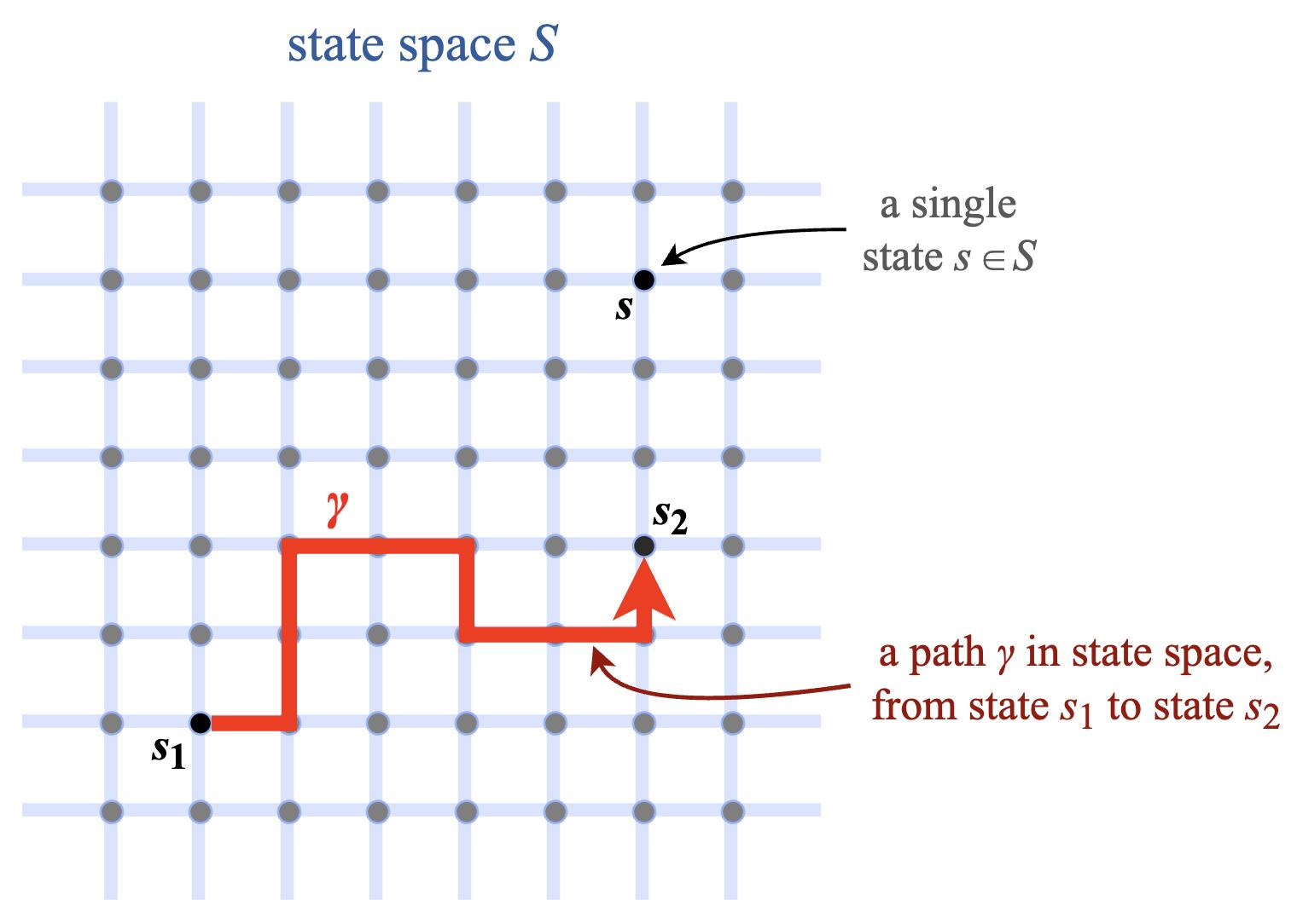
State space.
Think about the problem geometrically.
We can think of the set of all possible states as forming something like a manifold, with “nearby states” being those an agent can get to by unit actions.

Slide 26
State space.
Think about the problem geometrically.
We can think of the set of all possible states as forming something like a manifold, with “nearby states” being those an agent can get to by unit actions.
Episodes become paths in this state space.
path length = number of time steps

Slide 27
State space can be really complicated.

Slide 28
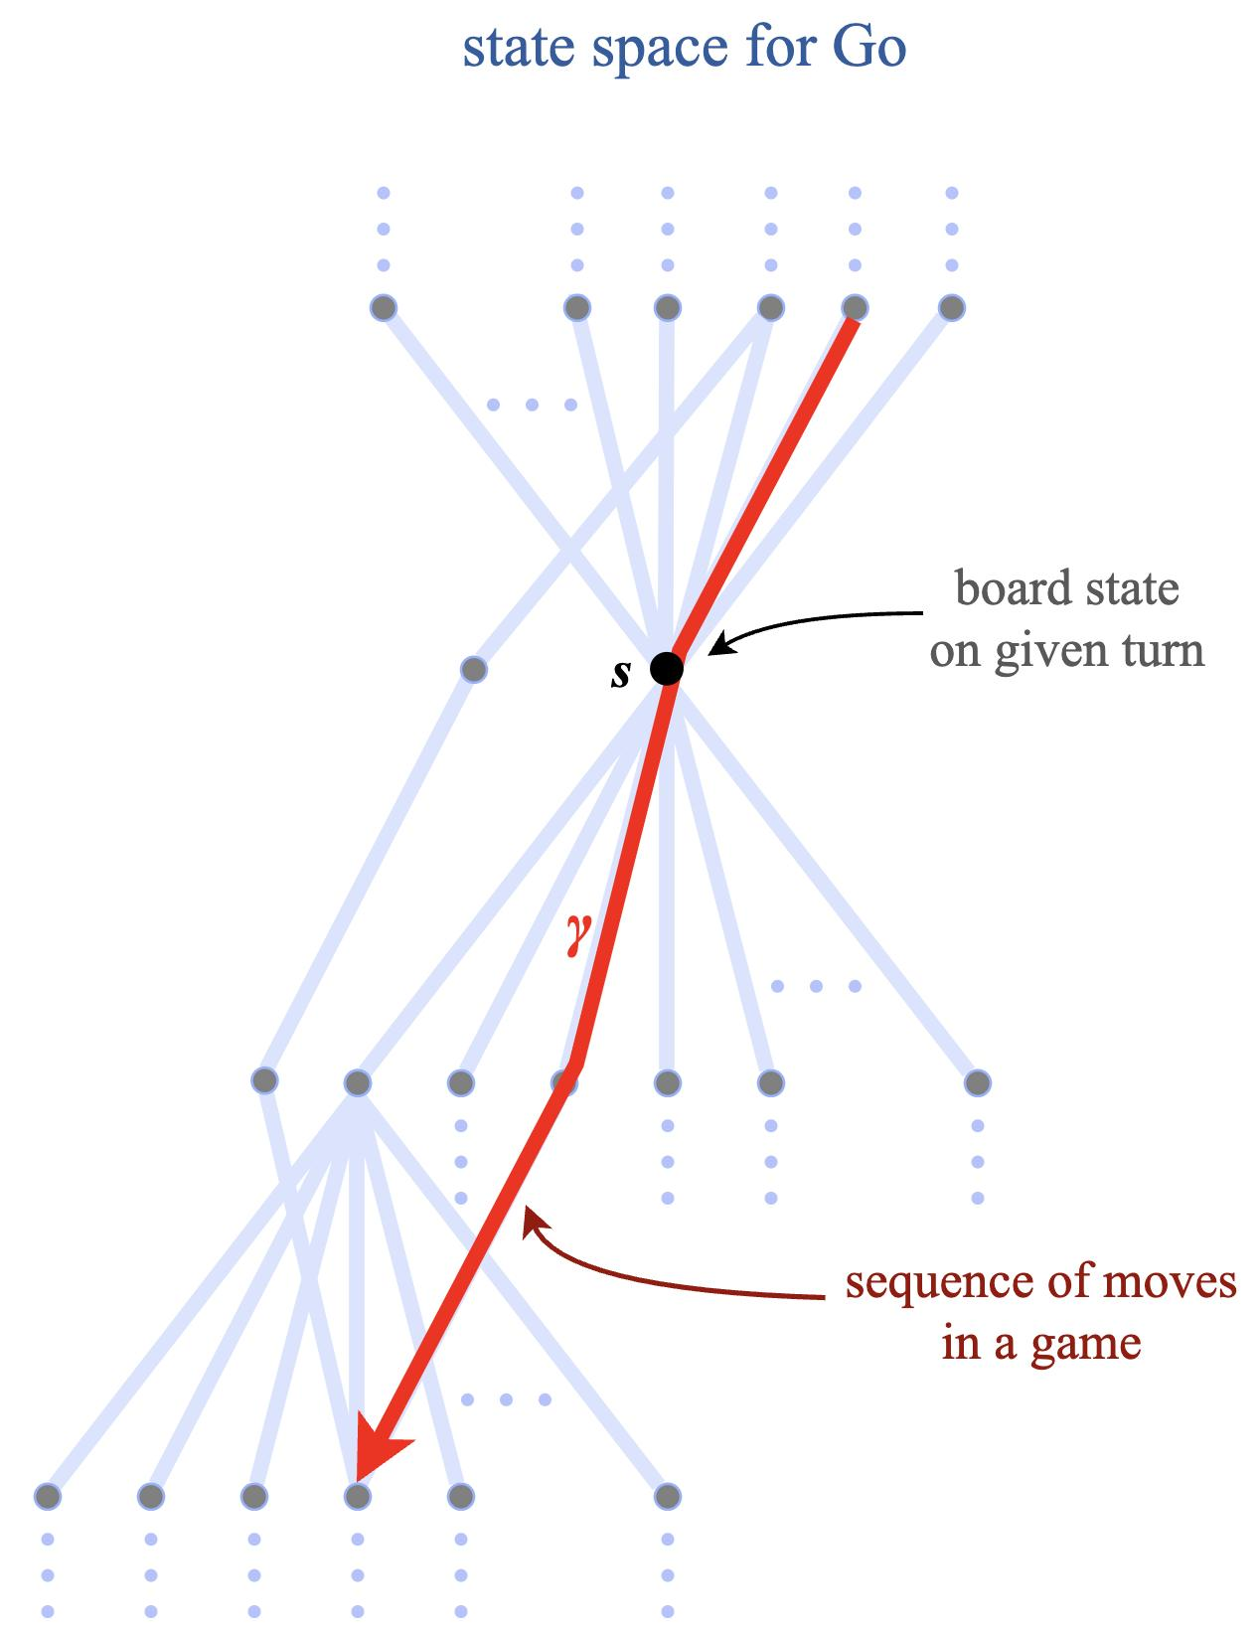
State space can be really complicated.

Slide 29
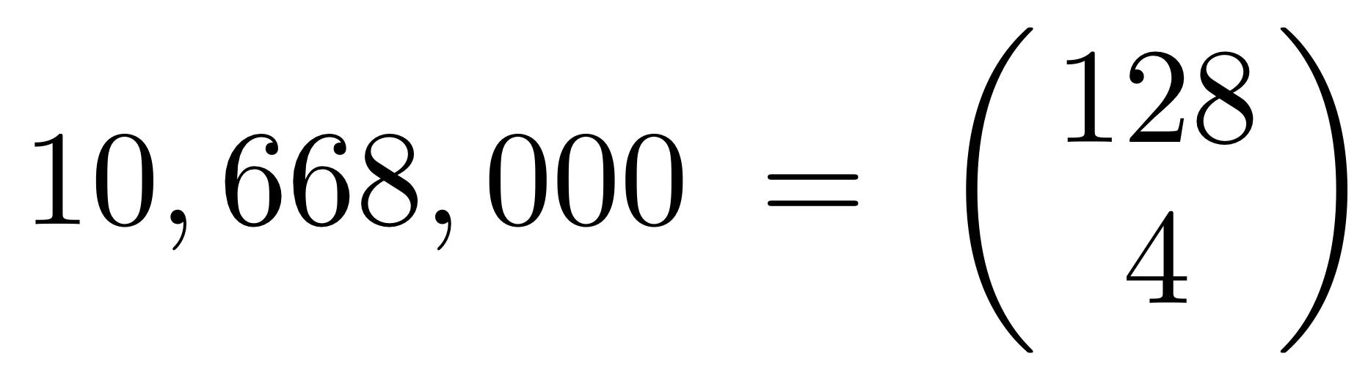
State space can be really complicated.
The state space for voice leading is the complete graph on 10,668,000 vertices:
K_{10,668,000}
Here .

Slide 30
Mathematical reformulation.

Slide 31
Mathematical reformulation.
We can now reformulate the basic problem of reinforcement learning in more mathematical language:

Slide 32
Mathematical reformulation.
We can now reformulate the basic problem of reinforcement learning in more mathematical language:
Focus on a single agent.

Slide 33
Mathematical reformulation.
We can now reformulate the basic problem of reinforcement learning in more mathematical language:
Focus on a single agent. Let s be our starting state.

Slide 34
Mathematical reformulation.
We can now reformulate the basic problem of reinforcement learning in more mathematical language:
Focus on a single agent. Let s be our starting state. Returns take the form of a real-valued function G.

Slide 35
Mathematical reformulation.
We can now reformulate the basic problem of reinforcement learning in more mathematical language:
Focus on a single agent. Let s be our starting state. Returns take the form of a real-valued function G. To each path γ in S starting at s, our function G assigns a real number G(γ):

Slide 36
Mathematical reformulation.
We can now reformulate the basic problem of reinforcement learning in more mathematical language:
Focus on a single agent. Let s be our starting state. Returns take the form of a real-valued function G. To each path γ in S starting at s, our function G assigns a real number G(γ):
G(γ) = the return to our agent when our episode is given by the path γ.

Slide 37
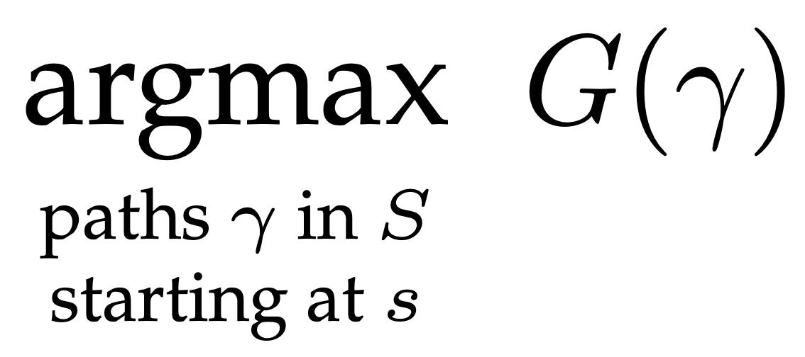
Mathematical reformulation.
We can now reformulate the basic problem of reinforcement learning in more mathematical language:
Focus on a single agent. Let s be our starting state. Returns take the form of a real-valued function G. To each path γ in S starting at s, our function G assigns a real number G(γ):
G(γ) = the return to our agent when our episode is given by the path γ.
Thus, the basic problem becomes that of computing

Slide 38
INTRACTABLE!

Slide 39
INTRACTABLE!
Solving this optimization problem, as stated, is intractable, as it requires the following steps:

Slide 40
INTRACTABLE!
Solving this optimization problem, as stated, is intractable, as it requires the following steps:
Compute the full state space S.

Slide 41
INTRACTABLE!
Solving this optimization problem, as stated, is intractable, as it requires the following steps:
Compute the full state space S.
Compute the associated 𝒫(S, s) ≝ set of all paths in S that start at s.

Slide 42
INTRACTABLE!
Solving this optimization problem, as stated, is intractable, as it requires the following steps:
Compute the full state space S.
Compute the associated 𝒫(S, s) ≝ set of all paths in S that start at s.
Determine the function G : 𝒫(S, s) → ℝ that computes the return G(γ) for every path γ in S that starts at s. Compute the value of G every path γ in S that starts at s.

Slide 43
INTRACTABLE!
Solving this optimization problem, as stated, is intractable, as it requires the following steps:
Compute the full state space S.
Compute the associated 𝒫(S, s) ≝ set of all paths in S that start at s.
Determine the function G : 𝒫(S, s) → ℝ that computes the return G(γ) for every path γ in S that starts at s. Compute the value of G every path γ in S that starts at s.
Choose a path γ ∈ 𝒫(S, s) so that G(γ) is maximal.

Slide 44
INTRACTABLE!
Solving this optimization problem, as stated, is intractable, as it requires the following steps:
Compute the full state space S.
Compute the associated 𝒫(S, s) ≝ set of all paths in S that start at s.
Determine the function G : 𝒫(S, s) → ℝ that computes the return G(γ) for every path γ in S that starts at s. Compute the value of G every path γ in S that starts at s.
Choose a path γ ∈ 𝒫(S, s) so that G(γ) is maximal.
We clearly need an alternate strategy.

Slide 45
Idea 1:

Slide 46
Idea 1: Let’s work from a more probabilistic perspective.

Slide 47
Idea 1: Let’s work from a more probabilistic perspective.
Consider an arbitrary agent, making many poor decisions as it moves in the state space S.

Slide 48
Idea 1: Let’s work from a more probabilistic perspective.
Consider an arbitrary agent, making many poor decisions as it moves in the state space S.
The agent traverses certain paths in S more often than others. In this way, the agent’s behaviour determines a probability distribution on 𝒫(S, s). We denote it π.

Slide 49
Idea 1: Let’s work from a more probabilistic perspective.
Consider an arbitrary agent, making many poor decisions as it moves in the state space S.
The agent traverses certain paths in S more often than others. In this way, the agent’s behaviour determines a probability distribution on 𝒫(S, s). We denote it π.
( path space )

Slide 50
Idea 1: Let’s work from a more probabilistic perspective.
Consider an arbitrary agent, making many poor decisions as it moves in the state space S.
The agent traverses certain paths in S more often than others. In this way, the agent’s behaviour determines a probability distribution on 𝒫(S, s). We denote it π.
a probabilistic
characterization
of our agent
( path space )

Slide 51
Idea 1: Let’s work from a more probabilistic perspective.
Consider an arbitrary agent, making many poor decisions as it moves in the state space S.
The agent traverses certain paths in S more often than others. In this way, the agent’s behaviour determines a probability distribution on 𝒫(S, s). We denote it π.
a probabilistic
characterization
of our agent
( path space )
The probability distribution π allows us to consider expected return for our agent:

Slide 52
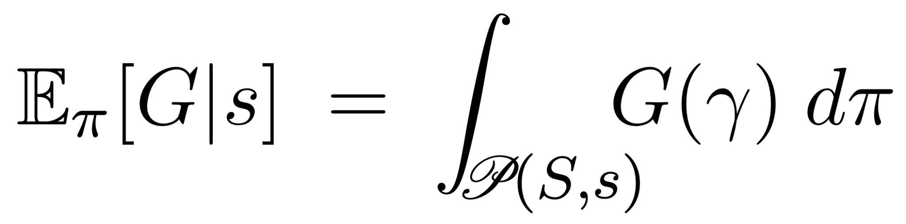
Idea 1: Let’s work from a more probabilistic perspective.
Consider an arbitrary agent, making many poor decisions as it moves in the state space S.
The agent traverses certain paths in S more often than others. In this way, the agent’s behaviour determines a probability distribution on 𝒫(S, s). We denote it π.
a probabilistic
characterization
of our agent
( path space )
The probability distribution π allows us to consider expected return for our agent:

Slide 53
Idea 1: Let’s work from a more probabilistic perspective.
Consider an arbitrary agent, making many poor decisions as it moves in the state space S.
The agent traverses certain paths in S more often than others. In this way, the agent’s behaviour determines a probability distribution on 𝒫(S, s). We denote it π.
a probabilistic
characterization
of our agent
( path space )
The probability distribution π allows us to consider expected return for our agent:
Super shifty integral!
We’re pretending we know how to integrate on 𝒫(S, s).

Slide 54
Idea 1: Let’s work from a more probabilistic perspective.
Consider an arbitrary agent, making many poor decisions as it moves in the state space S.
The agent traverses certain paths in S more often than others. In this way, the agent’s behaviour determines a probability distribution on 𝒫(S, s). We denote it π.
a probabilistic
characterization
of our agent
( path space )
The probability distribution π allows us to consider expected return for our agent:
Super shifty integral!
We’re pretending we know how to integrate on 𝒫(S, s).
But too useful to reject!

Slide 55
Idea 2:

Slide 56
Idea 2: Break-up path integral over immediate possible actions.

Slide 57
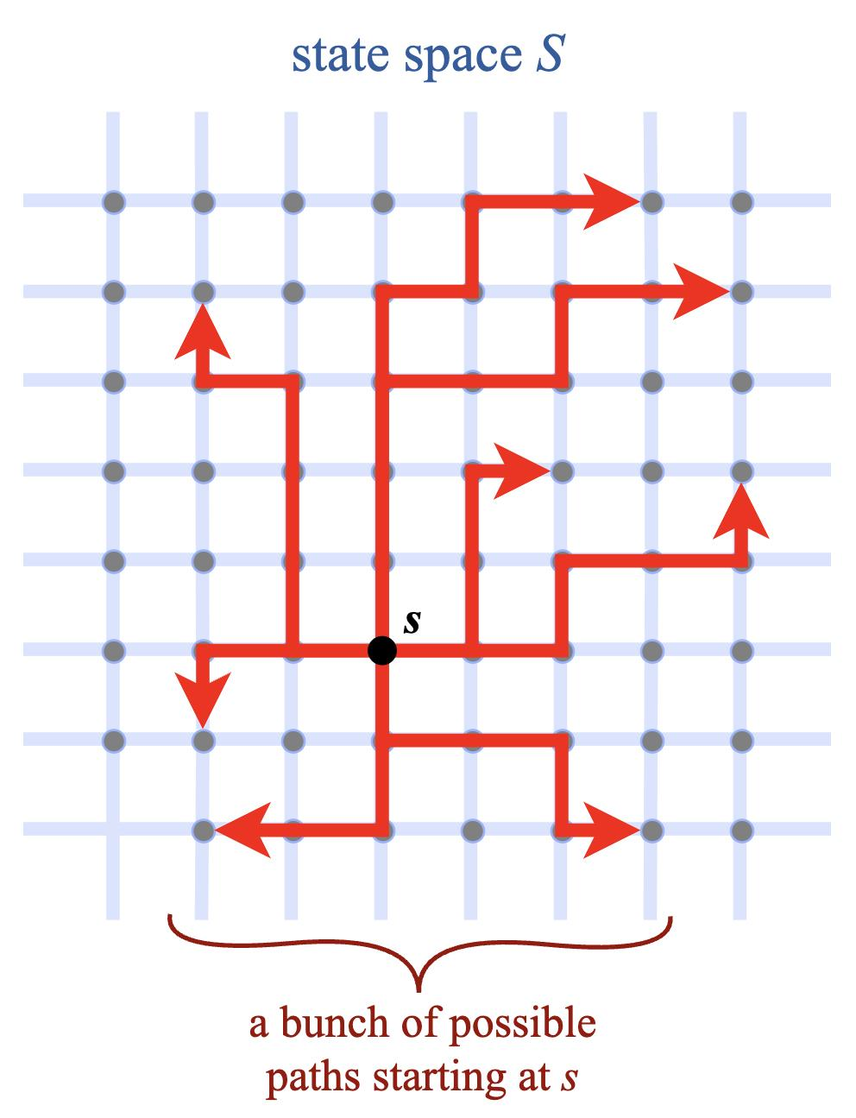
Idea 2: Break-up path integral over immediate possible actions.

Slide 58
Idea 2: Break-up path integral over immediate possible actions.
We’re supposed to
sum the values of G
over all paths!

Slide 59
Idea 2: Break-up path integral over immediate possible actions.
We’re supposed to
sum the values of G
over all paths!
Very hard to
keep track of!

Slide 60
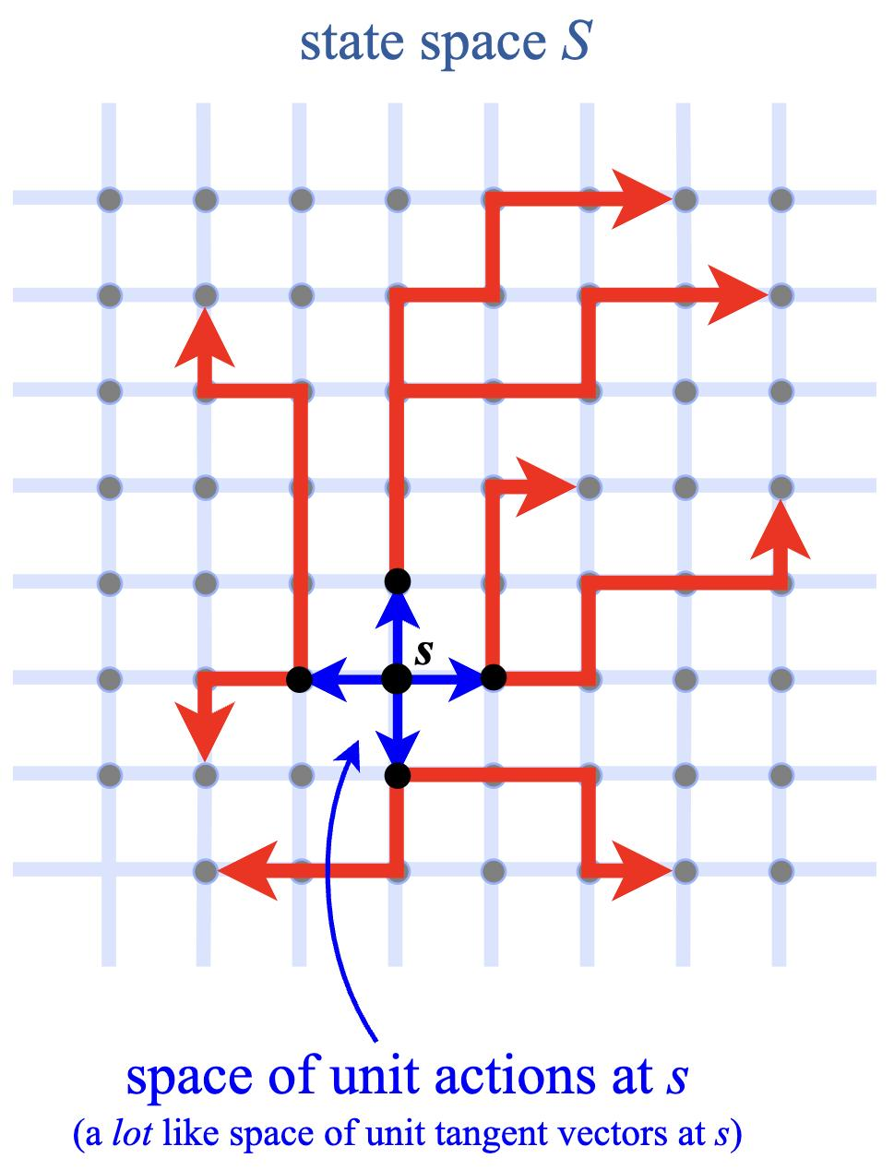
Idea 2: Break-up path integral over immediate possible actions.
We’re supposed to
sum the values of G
over all paths!
Very hard to
keep track of!

Slide 61
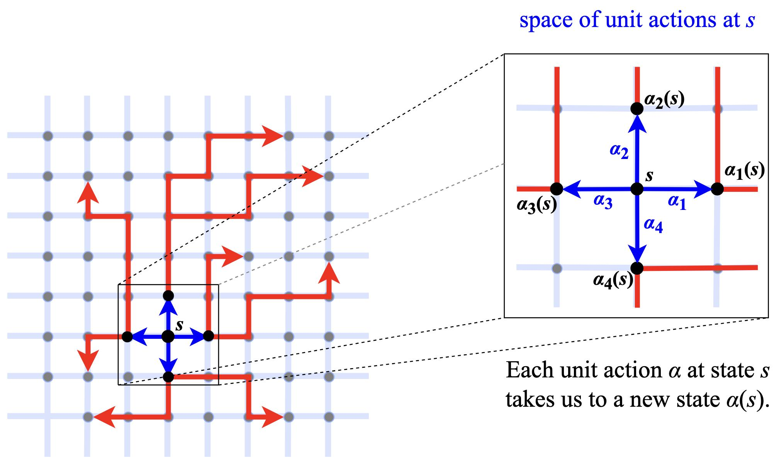

Slide 62
Picture suggests
an alternate way
to compute the
path integral.

Slide 63
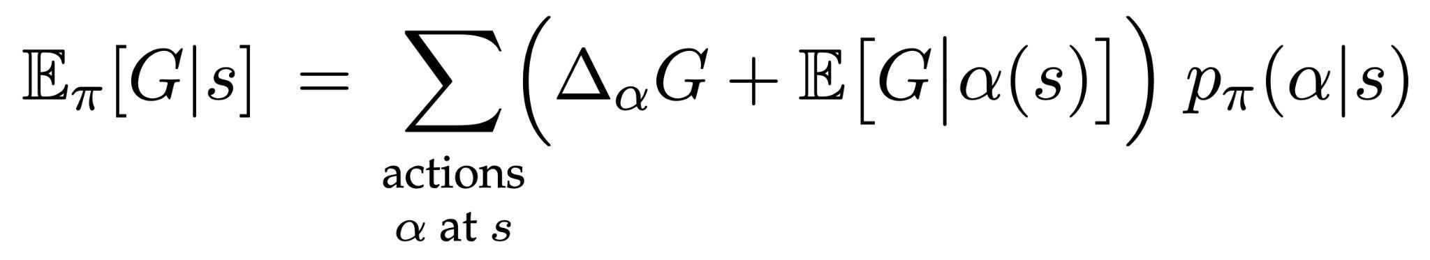
Picture suggests
an alternate way
to compute the
path integral.
π

Slide 64
Picture suggests
an alternate way
to compute the
path integral.
π
expected return if agent
takes action α at s

Slide 65
Picture suggests
an alternate way
to compute the
path integral.
π
expected return if agent
takes action α at s
probability that our agent will choose action α at s

Slide 66
Picture suggests
an alternate way
to compute the
path integral.
π
contribution of
α to final return
probability that our agent will choose action α at s

Slide 67
Picture suggests
an alternate way
to compute the
path integral.
π
expected return if agent
takes action α at s
probability that our agent will choose action α at s

Slide 68
Idea 3:

Slide 69
Idea 3: Focus on a single action.

Slide 70
Idea 3: Focus on a single action.
The sum in the last equation is a lot to keep track of, so let’s consider just one action α.

Slide 71
Picture suggests
an alternate way
to compute the
path integral.
π
expected return if agent
takes action α at s
probability that our agent will choose action α at s

Slide 72
Idea 3: Focus on a single action.
The sum in the last equation is a lot to keep track of, so let’s consider just one action α.

Slide 73
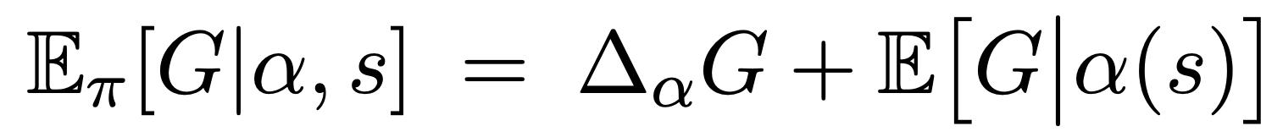
Idea 3: Focus on a single action.
The sum in the last equation is a lot to keep track of, so let’s consider just one action α.
def
π

Slide 74
Idea 3: Focus on a single action.
The sum in the last equation is a lot to keep track of, so let’s consider just one action α.
def
π
expected return
after taking
action α at state s

Slide 75
Idea 3: Focus on a single action.
The sum in the last equation is a lot to keep track of, so let’s consider just one action α.
def
π
expected return
after taking
action α at state s
these don’t match

Slide 76
Idea 3: Focus on a single action.
The sum in the last equation is a lot to keep track of, so let’s consider just one action α.
def
π
expected return
after taking
action α at state s
these don’t match,
so let’s expand…

Slide 77
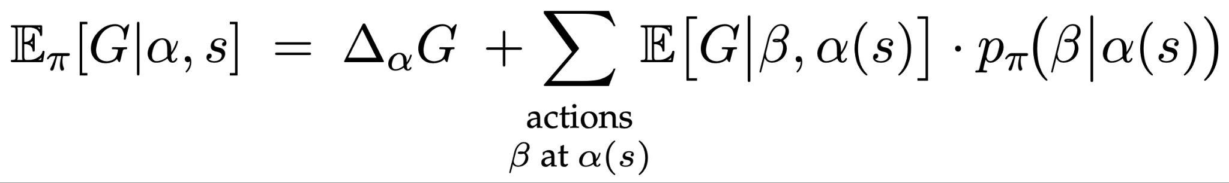
Idea 3: Focus on a single action.
The sum in the last equation is a lot to keep track of, so let’s consider just one action α.
def
π
expected return
after taking
action α at state s
π

Slide 78
Idea 3: Focus on a single action.
The sum in the last equation is a lot to keep track of, so let’s consider just one action α.
def
π
expected return
after taking
action α at state s
This is just
our previous
integral equation.
π

Slide 79
Picture suggests
an alternate way
to compute the
path integral.
π
expected return if agent
takes action α at s
probability that our agent will choose action α at s

Slide 80
Idea 3: Focus on a single action.
The sum in the last equation is a lot to keep track of, so let’s consider just one action α.
def
π
expected return
after taking
action α at state s
π

Slide 81
Idea 3: Focus on a single action.
The sum in the last equation is a lot to keep track of, so let’s consider just one action α.
def
π
expected return
after taking
action α at state s
new instance
π

Slide 82
π

Slide 83
π
A recursive equation involving two real-valued functions that take the same arguments:

Slide 84
π
A recursive equation involving two real-valued functions that take the same arguments:
𝔼_{π}[G|-, -] and p_{π}(- | -)

Slide 85
π
A recursive equation involving two real-valued functions that take the same arguments:
𝔼_{π}[G|-, -] and p_{π}(- | -)
action
state
action
state

Slide 86
π
A recursive equation involving two real-valued functions that take the same arguments:
𝔼_{π}[G|-, -] and p_{π}(- | -)
No explicit path integrals!
action
state
action
state

Slide 87
π
A recursive equation involving two real-valued functions that take the same arguments:
𝔼_{π}[G|-, -] and p_{π}(- | -)
No explicit path integrals!
action
state
action
state
Two primary strategies for using this equation to train agents via machine learning:

Slide 88
π
A recursive equation involving two real-valued functions that take the same arguments:
𝔼_{π}[G|-, -] and p_{π}(- | -)
No explicit path integrals!
action
state
action
state
Two primary strategies for using this equation to train agents via machine learning:
Action-value gradient methods, focusing on 𝔼_{π}[G|-, -].

Slide 89
π
A recursive equation involving two real-valued functions that take the same arguments:
𝔼_{π}[G|-, -] and p_{π}(- | -)
No explicit path integrals!
action
state
action
state
Two primary strategies for using this equation to train agents via machine learning:
Action-value gradient methods, focusing on 𝔼_{π}[G|-, -].
often called the value function

Slide 90
π
A recursive equation involving two real-valued functions that take the same arguments:
𝔼_{π}[G|-, -] and p_{π}(- | -)
No explicit path integrals!
action
state
action
state
Two primary strategies for using this equation to train agents via machine learning:
Action-value gradient methods, focusing on 𝔼_{π}[G|-, -].
Policy gradient methods, focusing on p_{π}(- | -).
often called the value function

Slide 91
Action-value gradient methods.

Slide 92
Action-value gradient methods.
Observation.

Slide 93
Action-value gradient methods.
Observation. We can imagine having already solved the problem:

Slide 94
Action-value gradient methods.
Observation. We can imagine having already solved the problem: our agent’s policy maximizes return,

Slide 95
Action-value gradient methods.
Observation. We can imagine having already solved the problem: our agent’s policy maximizes return, thus for each state s, the distribution p_{π}(α|s) is a dirac delta supported on a single action α that maximizes the return.

Slide 96
Action-value gradient methods.
Observation. We can imagine having already solved the problem: our agent’s policy maximizes return, thus for each state s, the distribution p_{π}(α|s) is a dirac delta supported on a single action α that maximizes the return.
But if this is the case, then the sum in our previous equation has only one term!

Slide 97
π

Slide 98
Action-value gradient methods.
Observation. We can imagine having already solved the problem: our agent’s policy maximizes return, thus for each s, the distribution p_{π}(α|s) is a dirac delta supported on a single action α that maximizes the return.
But if this is the case, then the sum in our previous equation has only one term!

Slide 99
Action-value gradient methods.
Observation. We can imagine having already solved the problem: our agent’s policy maximizes return, thus for each state s, the distribution p_{π}(α|s) is a dirac delta supported on a single action α that maximizes the return.
But if this is the case, then the sum in our previous equation has only one term!
The equation becomes

Slide 100
Action-value gradient methods.
Observation. We can imagine having already solved the problem: our agent’s policy maximizes return, thus for each state s, the distribution p_{π}(α|s) is a dirac delta supported on a single action α that maximizes the return.
But if this is the case, then the sum in our previous equation has only one term!
The equation becomes
Main idea behind the action-value gradient method:

Slide 101
Action-value gradient methods.
Observation. We can imagine having already solved the problem: our agent’s policy maximizes return, thus for each state s, the distribution p_{π}(α|s) is a dirac delta supported on a single action α that maximizes the return.
But if this is the case, then the sum in our previous equation has only one term!
The equation becomes
Main idea behind the action-value gradient method:
Use this equation as a loss function to approximate 𝔼_{π}[G|-, -].

Slide 102
Basic Strategy 1 (action-value gradient method).

Slide 103
Basic Strategy 1 (action-value gradient method).
Determine the reward R_{α} ≝ Δ_{α}G for each action α.

Slide 104
Basic Strategy 1 (action-value gradient method).
Determine the reward R_{α} ≝ Δ_{α}G for each action α.
Build an ML model 𝒱(-,-) to approximate the unknown function 𝔼_{π}[G|-, -].

Slide 105
Basic Strategy 1 (action-value gradient method).
Determine the reward R_{α} ≝ Δ_{α}G for each action α.
Build an ML model 𝒱(-,-) to approximate the unknown function 𝔼_{π}[G|-, -].
Have the agent move through state space S as follows:

Slide 106
Basic Strategy 1 (action-value gradient method).
Determine the reward R_{α} ≝ Δ_{α}G for each action α.
Build an ML model 𝒱(-,-) to approximate the unknown function 𝔼_{π}[G|-, -].
Have the agent move through state space S as follows: At any given state s, the agent chooses the action α that maximizes 𝒱(α,s)

Slide 107
Basic Strategy 1 (action-value gradient method).
Determine the reward R_{α} ≝ Δ_{α}G for each action α.
Build an ML model 𝒱(-,-) to approximate the unknown function 𝔼_{π}[G|-, -].
Have the agent move through state space S as follows: At any given state s, the agent chooses the action α that maximizes 𝒱(α,s) (again, 𝒱 is supposed to approximate expected return).

Slide 108
Basic Strategy 1 (action-value gradient method).
Determine the reward R_{α} ≝ Δ_{α}G for each action α.
Build an ML model 𝒱(-,-) to approximate the unknown function 𝔼_{π}[G|-, -].
Have the agent move through state space S as follows: At any given state s, the agent chooses the action α that maximizes 𝒱(α,s) (again, 𝒱 is supposed to approximate expected return).
After each episode, adjust the parameters of 𝒱 with respect to the equation
𝒱(α,s) = R_{α} + 𝒱(β,α(s))

Slide 109
Basic Strategy 1 (action-value gradient method).
Determine the reward R_{α} ≝ Δ_{α}G for each action α.
Build an ML model 𝒱(-,-) to approximate the unknown function 𝔼_{π}[G|-, -].
Have the agent move through state space S as follows: At any given state s, the agent chooses the action α that maximizes 𝒱(α,s) (again, 𝒱 is supposed to approximate expected return).
After each episode, adjust the parameters of 𝒱 with respect to the equation
𝒱(α,s) = R_{α} + 𝒱(β,α(s))
via the loss function ℒ(α,s) = || R_{α} + 𝒱(β,α(s)) -𝒱(α,s) ||.

Slide 110
Basic Strategy 1 (action-value gradient method).
Determine the reward R_{α} ≝ Δ_{α}G for each action α.
Build an ML model 𝒱(-,-) to approximate the unknown function 𝔼_{π}[G|-, -].
Have the agent move through state space S as follows: At any given state s, the agent chooses the action α that maximizes 𝒱(α,s) (again, 𝒱 is supposed to approximate expected return).
After each episode, adjust the parameters of 𝒱 with respect to the equation
𝒱(α,s) = R_{α} + 𝒱(β,α(s))
via the loss function ℒ(α,s) = || R_{α} + 𝒱(β,α(s)) -𝒱(α,s) ||.
I like to think of this as an ML model 𝒱 equipped with an API (the agent) that uses the outputs of 𝒱 as instructions for how to go get new data for the next training epoch.

Slide 111
Basic Strategy 1 (action-value gradient method).
Determine the reward R_{α} ≝ Δ_{α}G for each action α.
Build an ML model 𝒱(-,-) to approximate the unknown function 𝔼_{π}[G|-, -].
Have the agent move through state space S as follows: At any given state s, the agent chooses the action α that maximizes 𝒱(α,s) (again, 𝒱 is supposed to approximate expected return).
After each episode, adjust the parameters of 𝒱 with respect to the equation
𝒱(α,s) = R_{α} + 𝒱(β,α(s))
via the loss function ℒ(α,s) = || R_{α} + 𝒱(β,α(s)) -𝒱(α,s) ||.
Once the network is trained, the agent can optimize its returns by always choosing the action α that maximizes 𝒱(α,s).

Slide 112
Policy gradient methods.

Slide 113
Policy gradient methods.
Remark. There is a way to derive the techniques I’m about to describe directly from our formulas for the expected return 𝔼_{π}[G|α,s], using a result called the Policy Gradient Theorem.

Slide 114
Policy gradient methods.
Remark. There is a way to derive the techniques I’m about to describe directly from our formulas for the expected return 𝔼_{π}[G|α,s], using a result called the Policy Gradient Theorem.
For the sake of this talk, I’m going to take a more direct route.

Slide 115
Policy gradient methods.
Remark. There is a way to derive the techniques I’m about to describe directly from our formulas for the expected return 𝔼_{π}[G|α,s], using a result called the Policy Gradient Theorem.
For the sake of this talk, I’m going to take a more direct route.
Observation.

Slide 116
Policy gradient methods.
Remark. There is a way to derive the techniques I’m about to describe directly from our formulas for the expected return 𝔼_{π}[G|α,s], using a result called the Policy Gradient Theorem.
For the sake of this talk, I’m going to take a more direct route.
Observation. Since the total return G is just a sum of the rewards R_{α} ≝ Δ_{α}G over all actions α in a given episode,

Slide 117
Policy gradient methods.
Remark. There is a way to derive the techniques I’m about to describe directly from our formulas for the expected return 𝔼_{π}[G|α,s], using a result called the Policy Gradient Theorem.
For the sake of this talk, I’m going to take a more direct route.
Observation. Since the total return G is just a sum of the rewards R_{α} ≝ Δ_{α}G over all actions α in a given episode, an agent that always follows an optimal strategy should have

Slide 118
Basic Strategy 2 (policy-gradient method).

Slide 119
Basic Strategy 2 (policy-gradient method).
Determine the reward R_{α} ≝ Δ_{α}G for each action α.

Slide 120
Basic Strategy 2 (policy-gradient method).
Determine the reward R_{α} ≝ Δ_{α}G for each action α.
Build a neural network 𝒬(-,-) to approximate the unknown function p_{π}(- | -).

Slide 121
Basic Strategy 2 (policy-gradient method).
Determine the reward R_{α} ≝ Δ_{α}G for each action α.
Build a neural network 𝒬(-,-) to approximate the unknown function p_{π}(- | -).
Have the agent move through state space S as follows: At any given state s, the agent chooses the action α that maximizes 𝒬(α, s) (since 𝒬 is supposed to approximate the agent’s policy function).

Slide 122
Basic Strategy 2 (policy-gradient method).
Determine the reward R_{α} ≝ Δ_{α}G for each action α.
Build a neural network 𝒬(-,-) to approximate the unknown function p_{π}(- | -).
Have the agent move through state space S as follows: At any given state s, the agent chooses the action α that maximizes 𝒬(α, s) (since 𝒬 is supposed to approximate the agent’s policy function).
After each episode, use the actual, selected actions in the episode to compute return:

Slide 123
Basic Strategy 2 (policy-gradient method).
Determine the reward R_{α} ≝ Δ_{α}G for each action α.
Build a neural network 𝒬(-,-) to approximate the unknown function p_{π}(- | -).
Have the agent move through state space S as follows: At any given state s, the agent chooses the action α that maximizes 𝒬(α, s) (since 𝒬 is supposed to approximate the agent’s policy function).
After each episode, use the actual, selected actions in the episode to compute return:

Slide 124
Basic Strategy 2 (policy-gradient method).
Determine the reward R_{α} ≝ Δ_{α}G for each action α.
Build a neural network 𝒬(-,-) to approximate the unknown function p_{π}(- | -).
Have the agent move through state space S as follows: At any given state s, the agent chooses the action α that maximizes 𝒬(α, s) (since 𝒬 is supposed to approximate the agent’s policy function).
After each episode, use the actual, selected actions in the episode to compute return:
We now want to train the model 𝒬(-,-) so that it approximates the “correct” policy p_{π}(- | -).

Slide 125
Basic Strategy 2 (policy-gradient method).
Determine the reward R_{α} ≝ Δ_{α}G for each action α.
Build a neural network 𝒬(-,-) to approximate the unknown function p_{π}(- | -).
Have the agent move through state space S as follows: At any given state s, the agent chooses the action α that maximizes 𝒬(α, s) (since 𝒬 is supposed to approximate the agent’s policy function).
After each episode, use the actual, selected actions in the episode to compute return:
We now want to train the model 𝒬(-,-) so that it approximates the “correct” policy p_{π}(- | -).
How do we characterize p_{π}(- | -)? …It is the policy that always maximizes expected return!

Slide 126
We want to train the model 𝒬(-,-) to approximate the policy maximizing expected return.

Slide 127
We want to train the model 𝒬(-,-) to approximate the policy maximizing expected return.
We’re looking for the right loss function for training this model 𝒬(-,-).

Slide 128
We want to train the model 𝒬(-,-) to approximate the policy maximizing expected return.
We’re looking for the right loss function for training this model 𝒬(-,-).
If 𝒬(α, s) is small, but 𝔼_{π}[G|α, s] is large, then 𝒬(α, s) should be larger.

Slide 129
We want to train the model 𝒬(-,-) to approximate the policy maximizing expected return.
We’re looking for the right loss function for training this model 𝒬(-,-).
If 𝒬(α, s) is small, but 𝔼_{π}[G|α, s] is large, then 𝒬(α, s) should be larger.
If 𝒬(α, s) is large, but 𝔼_{π}[G|α, s] is small, then 𝒬(α, s) should be smaller.

Slide 130
We want to train the model 𝒬(-,-) to approximate the policy maximizing expected return.
We’re looking for the right loss function for training this model 𝒬(-,-).
If 𝒬(α, s) is small, but 𝔼_{π}[G|α, s] is large, then 𝒬(α, s) should be larger.
If 𝒬(α, s) is large, but 𝔼_{π}[G|α, s] is small, then 𝒬(α, s) should be smaller.
One loss function with these properties is “cross entropy” between 𝔼_{π}[G|α, s] and 𝒬(α, s):

Slide 131
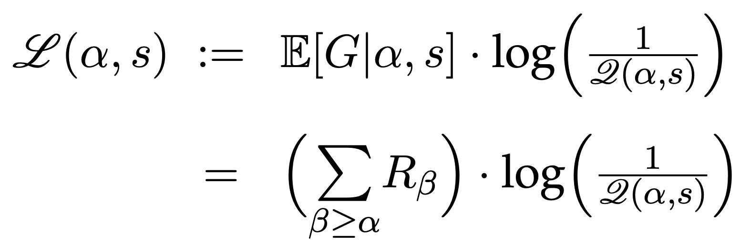
We want to train the model 𝒬(-,-) to approximate the policy maximizing expected return.
We’re looking for the right loss function for training this model 𝒬(-,-).
If 𝒬(α, s) is small, but 𝔼_{π}[G|α, s] is large, then 𝒬(α, s) should be larger.
If 𝒬(α, s) is large, but 𝔼_{π}[G|α, s] is small, then 𝒬(α, s) should be smaller.
One loss function with these properties is “cross entropy” between 𝔼_{π}[G|α, s] and 𝒬(α, s):

Slide 132
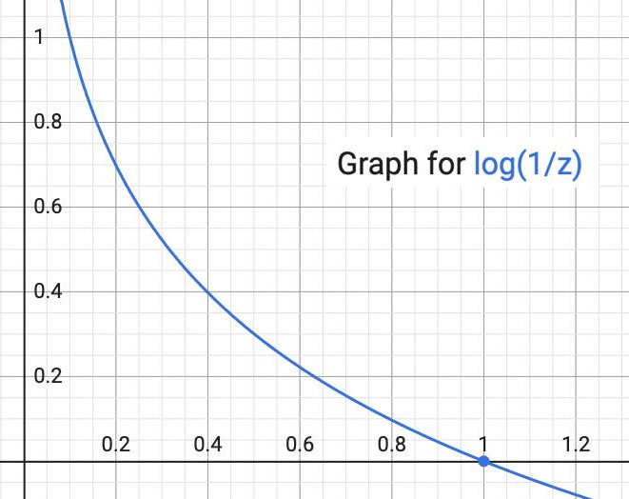

Slide 133
Basic Strategy 2 (policy-gradient methods).
Determine the reward R_{α} ≝ Δ_{α}G for each action α.
Build a neural network 𝒬(-,-) to approximate the unknown function p_{π}(- | -).
Have the agent move through state space S as follows: At any given state s, the agent chooses the action α that maximizes 𝒬(α, s) (since 𝒬 is supposed to approximate the agent’s policy function).
After each episode, use the actual, selected actions in the episode to compute return:

Slide 134
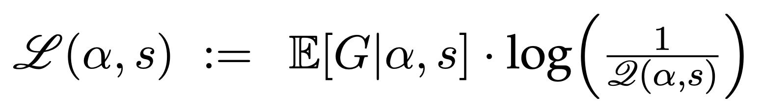
Basic Strategy 2 (policy-gradient method).
Determine the reward R_{α} ≝ Δ_{α}G for each action α.
Build a neural network 𝒬(-,-) to approximate the unknown function p_{π}(- | -).
Have the agent move through state space S as follows: At any given state s, the agent chooses the action α that maximizes 𝒬(α, s) (since 𝒬 is supposed to approximate the agent’s policy function).
After each episode, use the actual, selected actions in the episode to compute return:
5. After each episode, run a training epoch looped over episode’s actions, with loss

